Slide 1
Warehouse Management
IDS 552
Guest Instructor: Parshan Pakiman

Slide 2
Discussion outline
Warehousing in online retailing
Warehousing basics
Decisions:
How to select equipment and technology
How to store products
How to pick and ship products (next class)

Slide 3
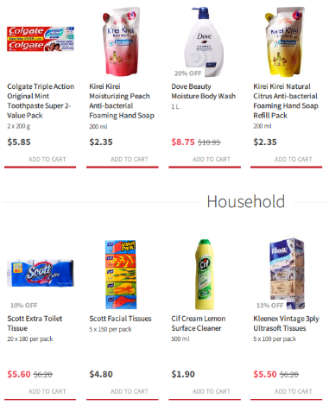
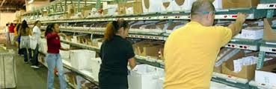
Logistics of online retailing
e-Commerce
Logistics

Slide 4
Supply chain of online retailing
Local Fulfillment Centers
Suppliers
Regional Warehouses
Consumers

Slide 5
Offline and online demand
The difference between fulfilment for offline and online demands
Fulfillment for offline demands:
Ship products to retail stores
Smaller number of orders
Large quantity for each order
Fulfillment for online demands:
Ship products to end consumers
Large number of orders
Small quantity for each order

Slide 6
Warehousing basics

Slide 7
Types of warehouses
Retail distribution center
Service parts distribution center
E-commerce distribution center (fulfillment center)
3rd Party Logistic (3PL) warehouse
Perishable warehouse
Notes:
A retail distribution center typically supplies product to retail stores, such as Wal-Mart or Target. The immediate customer of the distribution center is a retail store, which is likely to be a regular or even captive customer, receiving shipments on regularly scheduled days.
Service parts distribution center: They hold spare parts for expensive capital equipment, such as automobiles, airplanes, computer systems, or medical equipment. Because of the large number of parts, total activity in the DC may be statistically predictable, but the demand for any particular part is relatively small and therefore hard to predict. This means that the variance of demand can
be large and so relatively large quantities of safety stock must be held. These skus require much space. This in turn increases travel distances and makes order-picking less efficient.
E-commerce distribution center typically receives small orders from individuals by phone, fax, or the Internet. Orders are typically small, for only 1–3 items, but there may be many such orders, and they are to be filled and shipped immediately after receipt. Because customer orders require instant response, such distributors typically try to shape demand by offering special prices for ordering at certain times or in certain quantities or for accepting more variable delivery dates.
A 3PL warehouse is one to which a company might outsource its warehousing operations. thereby gaining economies of scale.
A perishables warehouse may handle food, fresh flowers, vaccines, or other product requiring refrigeration to protect its very short shelf life. Such DCs are distinctive in that product dwells within for very short times, frequently only hours. Also, there is a great emphasis on using space effectively because, with refrigeration, it is so expensive. They face many challenges in inventory management, including requirements to ship product according to FIFO (First-In-First-Out) or FEFO (First-Expired-First-Out). Also, there are typically many restrictions on how product is handled.

Slide 8
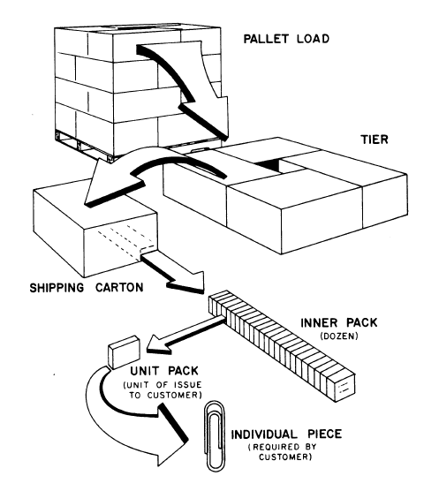
Units of handling
Notes:
A stock keeping unit, or SKU, is the smallest physical unit of a product that is tracked by an organization. Upstream in the supply chain, product generally flows in larger units, such as pallets; and is successively broken down into smaller units as it moves downstream, as
suggested in Figure 2.2. Thus a product might move out of the factory and to regional distribution centers in pallet-loads; and then to local warehouses in cases; and finally to retail stores in inner-packs or even individual pieces, which are the smallest units offered to the consumer.

Slide 9
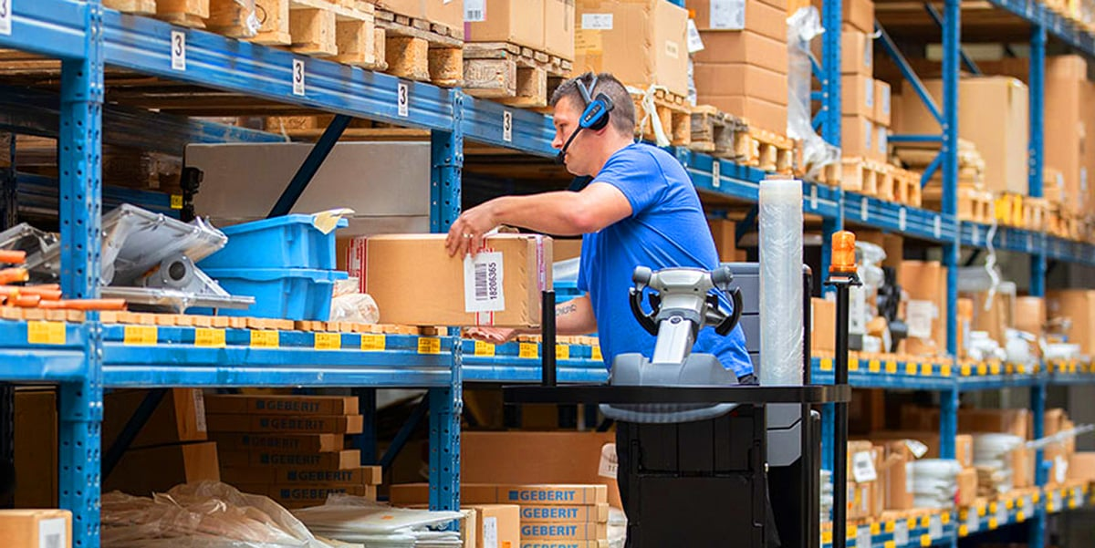
Warehouse operations
Order-picking
Pallet picking
Case picking
Piece picking
Put-away
Checking & packing
Receiving
Shipping
Order-picking costs about 55% of the total operating expense.
Within order-picking, traveling is the most time-consuming.

Slide 10
How to fulfill orders?
How to select equipment and technology
How to store products
How to pick and ship products

Slide 11
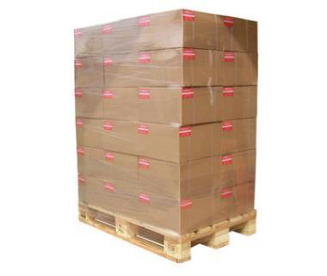
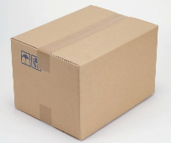

Scenario 1:
Pallet
Scenario 2:
Carton
Scenario 3:
Piece
When does each of these scenarios occur?

Slide 12
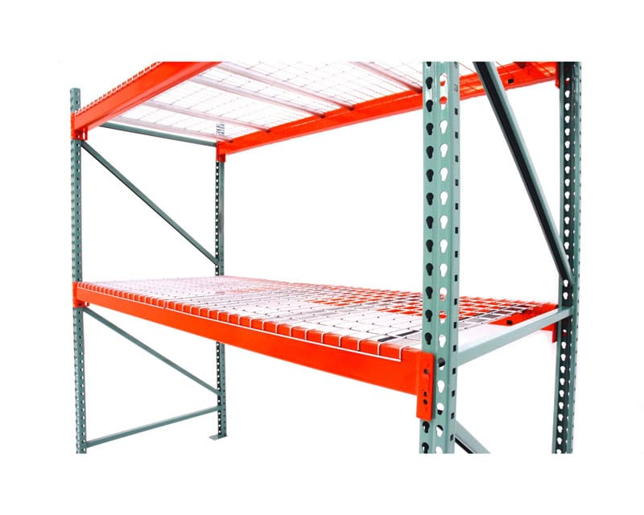
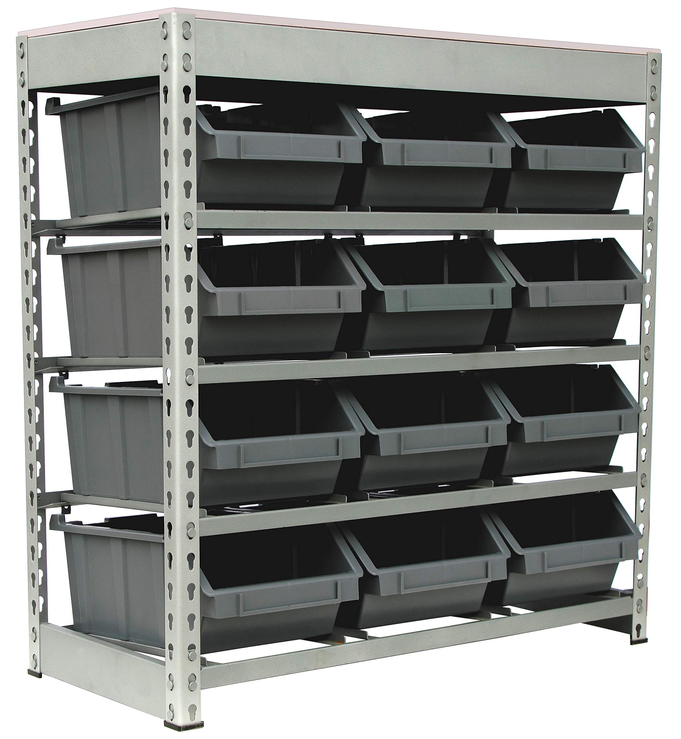
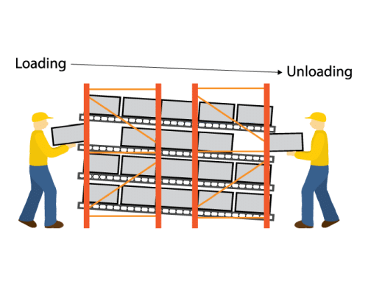
Storage equipment
Pallet or case picking
Pallet racks
Bulk storage
Piece picking
Bin-shelving
Slower-moving items
Gravity flow racks
Faster-moving items

Slide 13
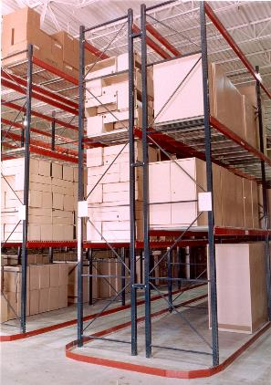
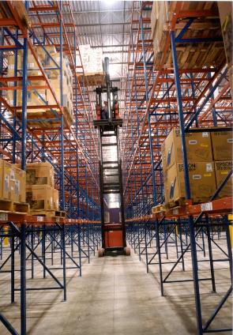
Single-deep racks
Easily accessible, require more aisle space

Slide 14
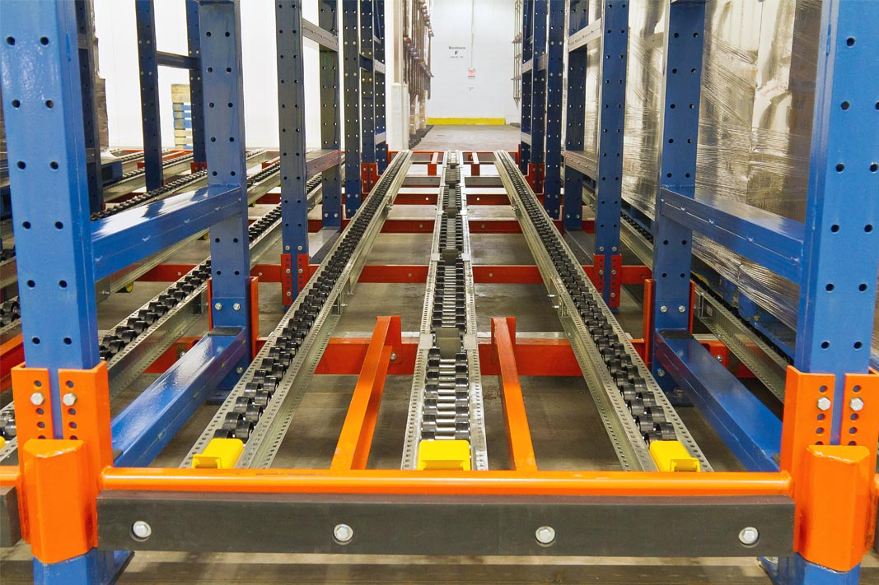
Pallet flow racks
Shelves are tilted with rollers
Picking and restocking are performed from different aisles
For high throughput skus

Slide 15
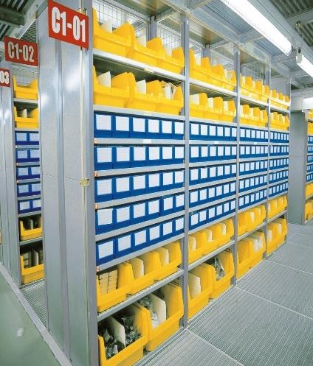
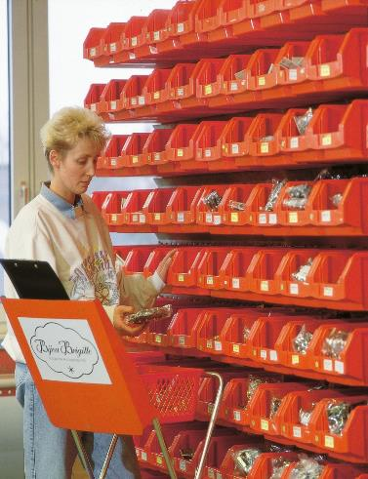
Bin-shelving

Slide 16
Bin-shelving
Shallow shelves
Both picking and restocking must be done from the pick face
Suitable for slower-moving skus

Slide 17
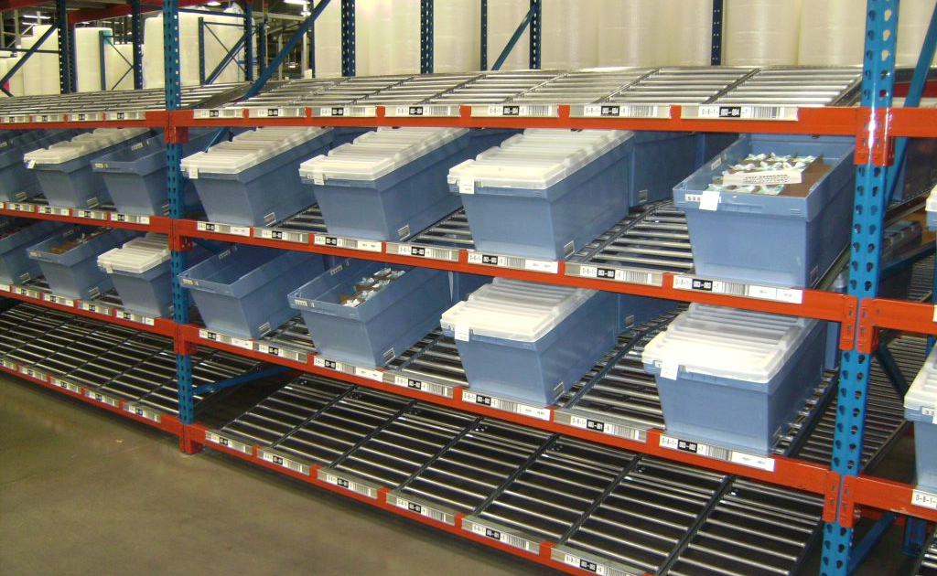
Gravity flow rack

Slide 18
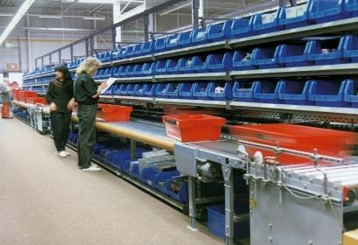
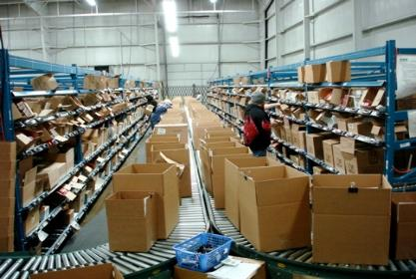
Gravity flow rack

Slide 19
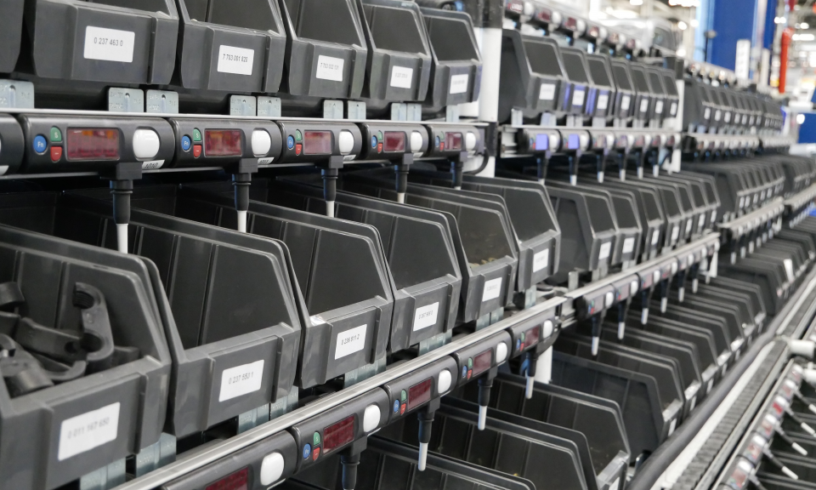
Gravity Flow Rack with a pick-to-light system

Slide 20
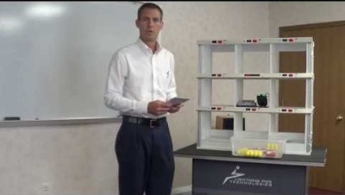
Gravity Flow Rack with a pick-to-light system

Slide 21
Gravity flow rack
Tilted and deep shelves
One case of a product on the pick face
High sku density
Some are supported by a pick-to-light system
Restock from the back
Suitable for faster-moving skus

Slide 22
Handling equipment
Turret Truck (Forklift)
Order-Picker Truck
AS/RS
Conveyor
Notes:
automated storage and retrieval systems (AS/RS)

Slide 23
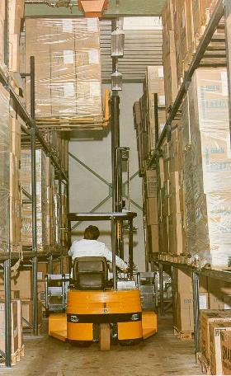
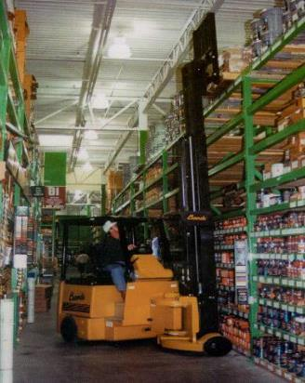
Turret truck
For very narrow aisles (5 to 7 feet)

Slide 24
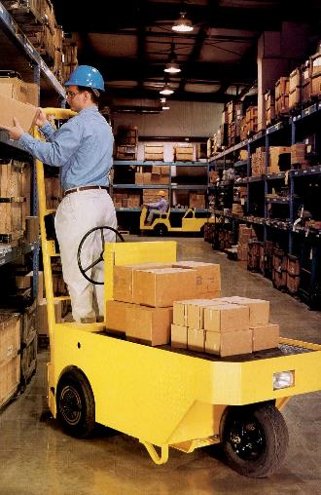
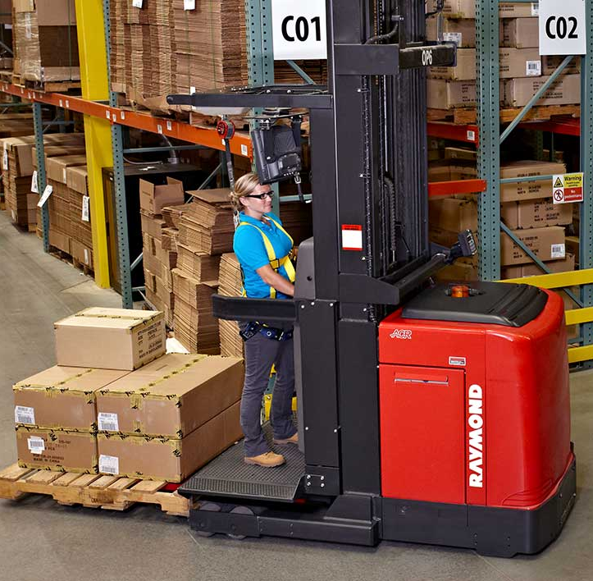
Order-picker trucks

Slide 25
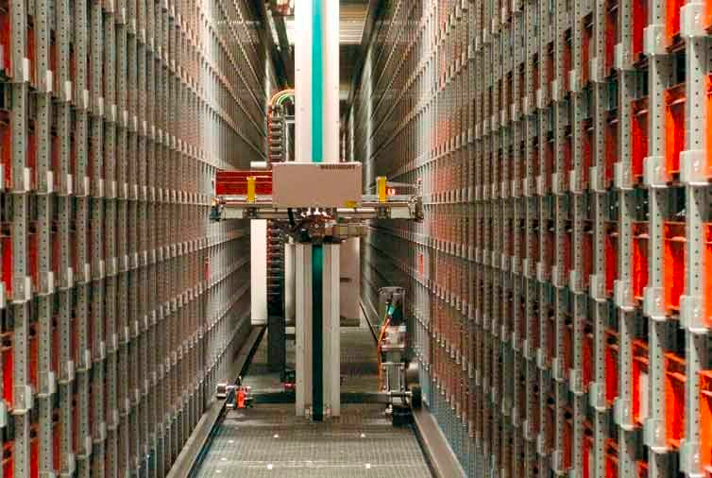
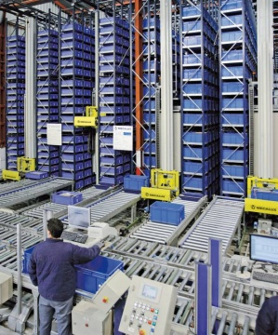
Automated storage and retrieval system (AS/RS)
https://www.youtube.com/watch?v=kdVet_UOx30&feature=related

Slide 26
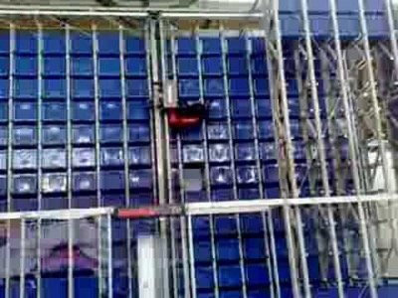
Automated storage and retrieval system (AS/RS)

Slide 27
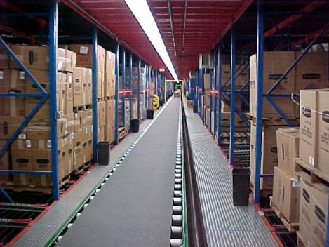
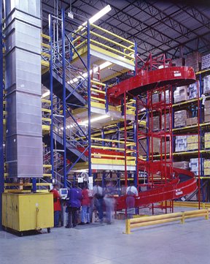
Conveyors
https://www.youtube.com/watch?v=KgpE1q9s9O0

Slide 28
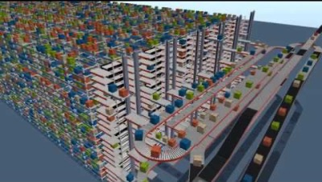
Conveyors

Slide 29
Conveyors
Change the economics of travel
Partition a warehouse into zones
Create problems of balancing work among zones
Store conveyable product far from shipping
Store non-conveyable product close to shipping

Slide 30
Other technologies
High-density storage systems
https://www.youtube.com/watch?v=iyVDMp2bL9c
Kiva robots
https://www.youtube.com/watch?v=UtBa9yVZBJM
Amazon’s drones
https://www.youtube.com/watch?v=Le46ERPMlWU
Meijer automation
https://www.youtube.com/watch?v=bn5jjVKhFUs

Slide 31
How to fulfill customer orders?
How to select equipment and technology
How to store products
How to pick and ship products

Slide 32
Fast-pick area
Reserve
Restock
Fast-pick area
Pick
Pick

Slide 33
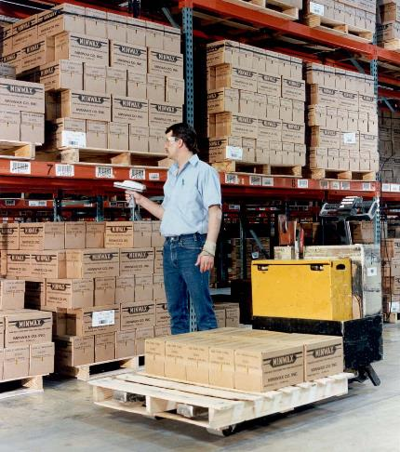
Fast-pick area (bottom of rack)

Slide 34
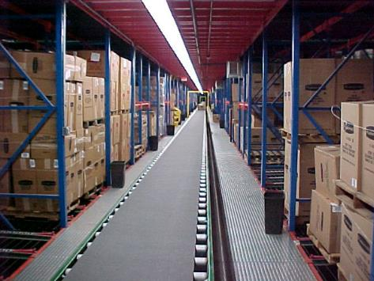
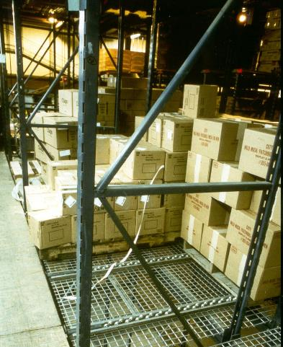
Fast-pick area (pallet flow rack)

Slide 35

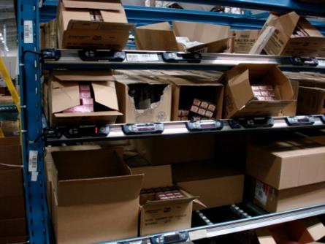
Fast-pick area (gravity flow rack)

Slide 36
Summary
How to fulfill customer orders?
How to select equipment and technology?
Pallet racks for pallets
Bin-shelving for slower-moving items
Gravity flow racks for faster-moving items
How to store products?
Use fast-pick areas to reduce response time
How to pick and ship products?

Slide 37
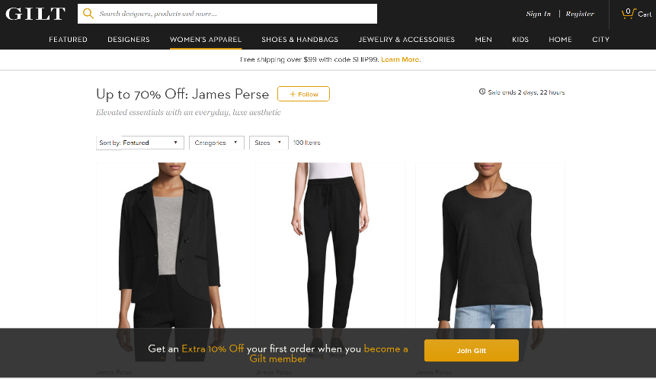
Logistics of online retailing

Slide 38
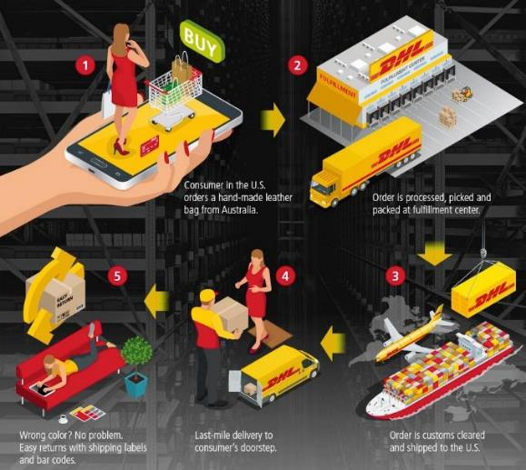
Logistics of online retailing

Slide 39
When and how much to order from each supplier?
Decision 1
Local Fulfillment Centers
Suppliers
Regional Warehouses
Consumers

Slide 40
How much to store in each warehouse for each product?
Decision 2
Suppliers
Regional Warehouses
Local Fulfillment Centers
Consumers

Slide 41
Which warehouse to retrieve from?
Decision 3
Local Fulfillment Centers
Suppliers
Regional Warehouses
Consumers

Slide 42
How to fulfill customer orders?
Decision 4
Local Fulfillment Centers
Suppliers
Regional Warehouses
Consumers

Slide 43
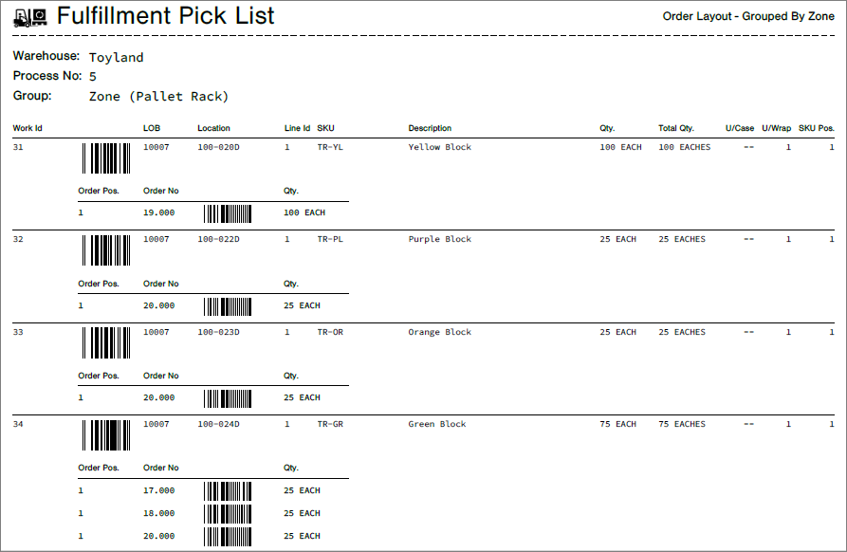
Sample pick list
Pick line

